Slide 1


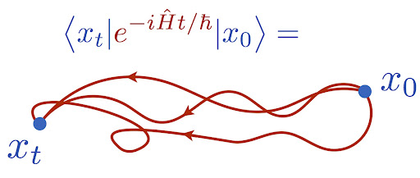
Topics on Path Integral Monte Carlo
Yichen Dou
PHYS551 final presentation

Slide 2

TODO List:
Review Path Integral
Show that Stat Mech = Path Integral (Euclidean Path).
Introduce to Markov Chain Monte Carlo (MCMC) Algorithm.
Metropolis Hasting Algorithm for Path Sampling.
Quantum Harmonic Oscillator Example.

Slide 3
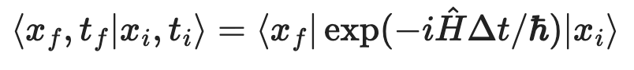
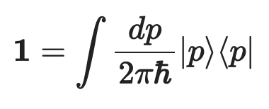
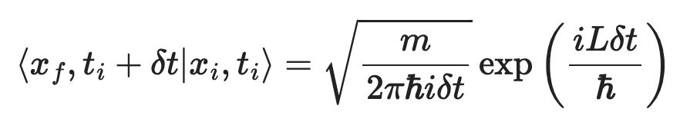
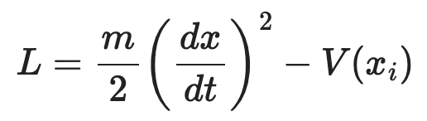
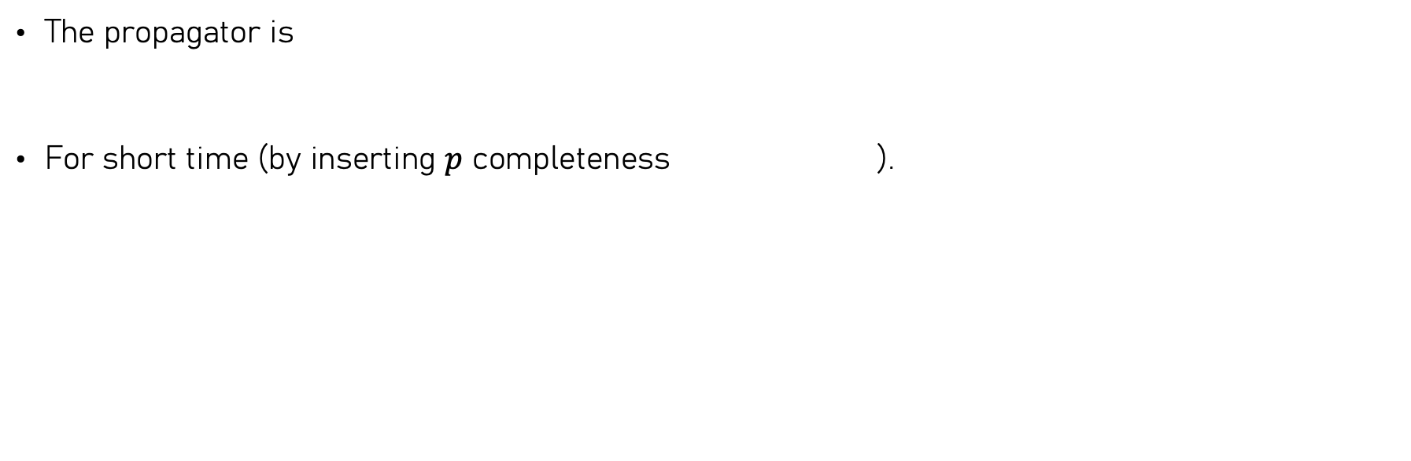
Review of Path Integral
The propagator is
For short time (by inserting $p$ completeness ).

Slide 4
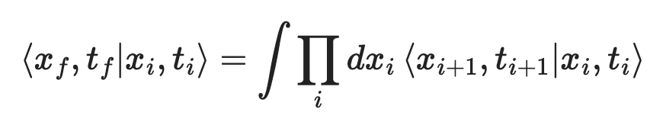
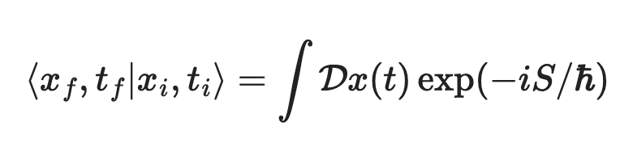
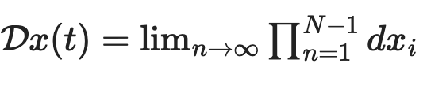
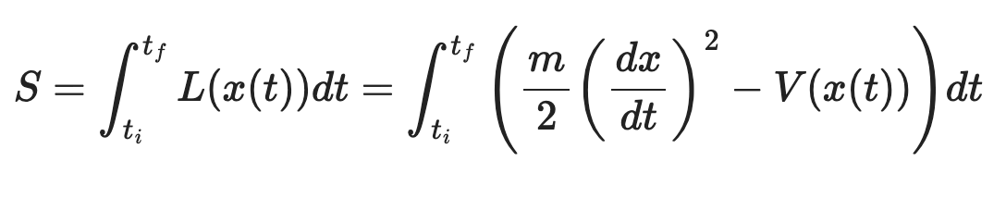
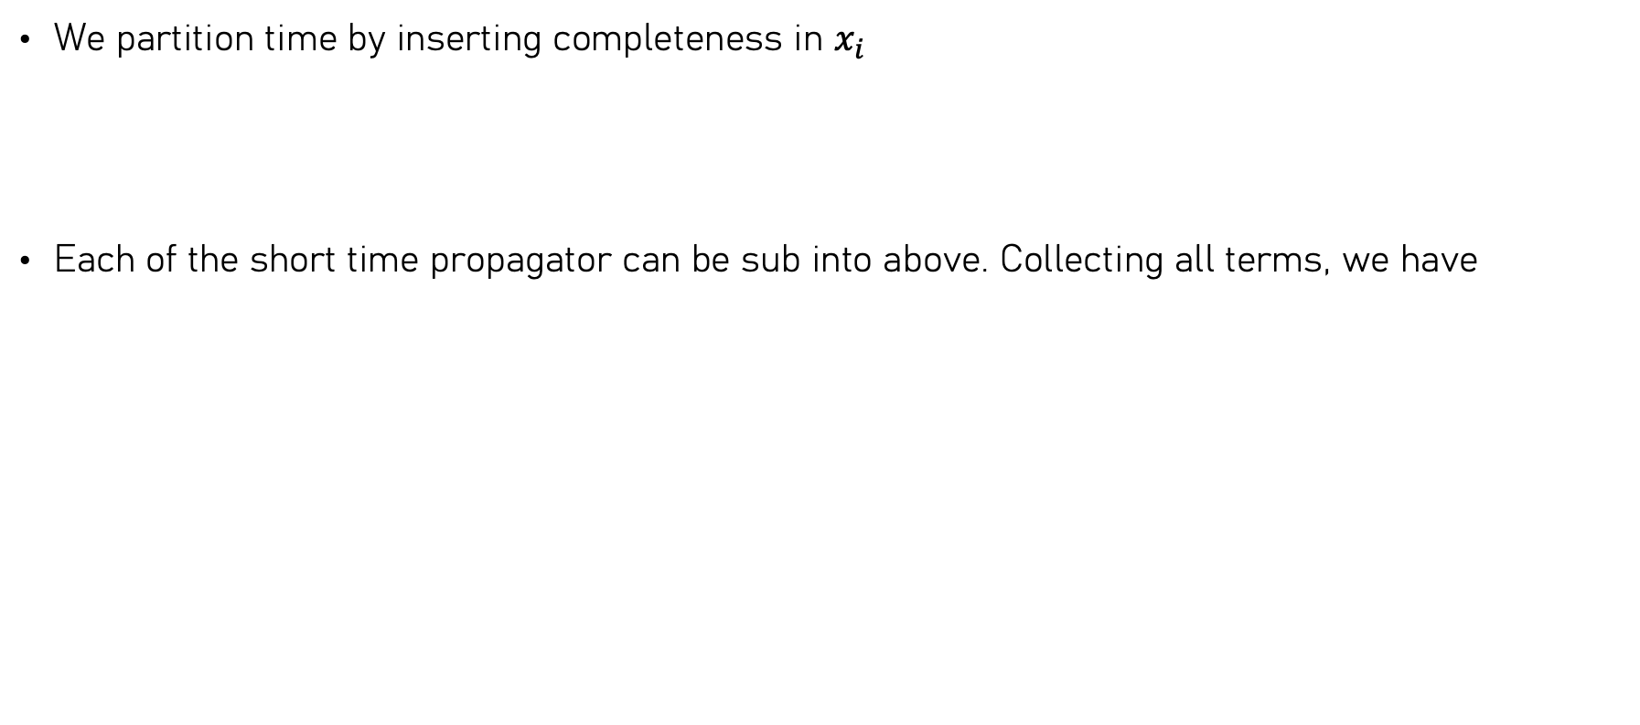
We partition time by inserting completeness in $x_{i}$
Each of the short time propagator can be sub into above. Collecting all terms, we have

Slide 5

TODO List:
Review Path Integral
Show that Stat Mech = Path Integral (Euclidean Path).
Introduce to Markov Chain Monte Carlo (MCMC) Algorithm.
Metropolis Hasting Algorithm for Path Sampling.
Quantum Harmonic Oscillator Example.

Slide 6

What has it to do with stat mech ???
Goal: Formulate Stat Mech into Path Integral

Slide 7
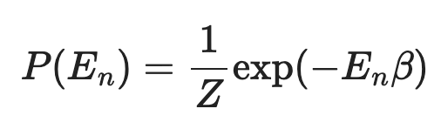
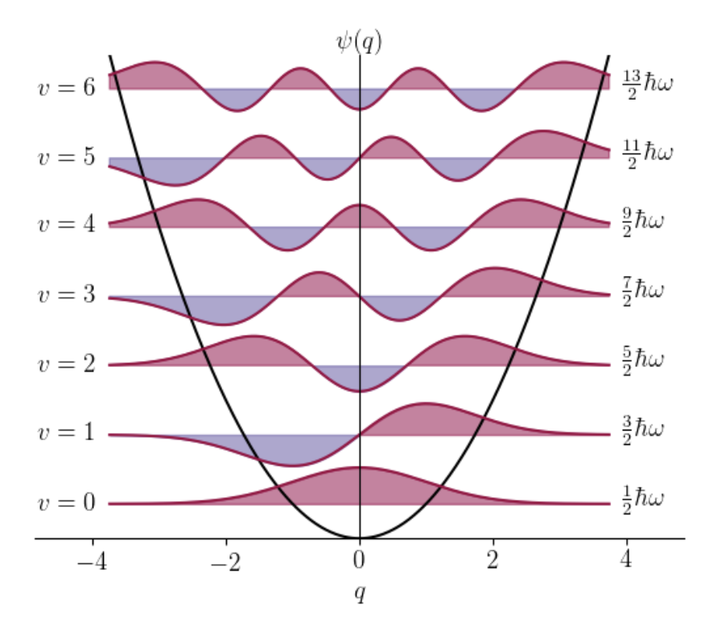
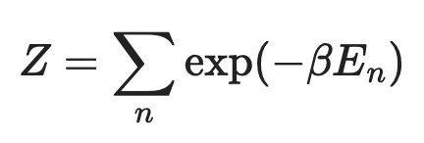
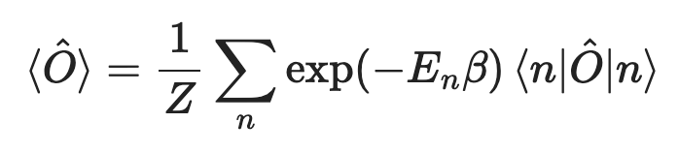
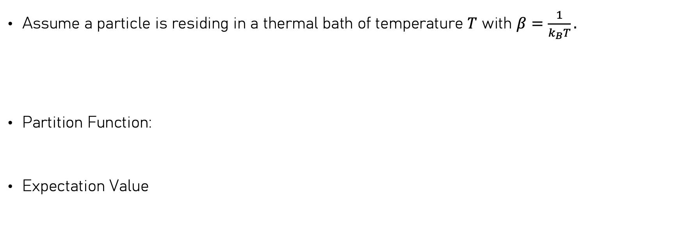
Some stat mech…
Assume a particle is residing in a thermal bath of temperature $T$ with $β=\frac{1}{k_{B}T}.$
Partition Function:
Expectation Value

Slide 8

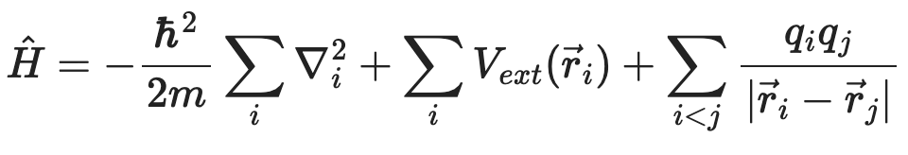
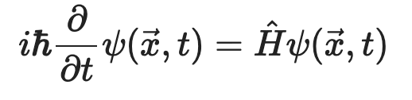

Problem…
It’s hard to find $E_{n}$ for many particles…
Ugly…

Slide 9
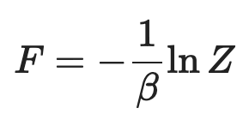
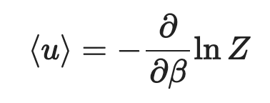


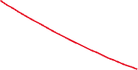

We can’t find the partition function! 😭😭😭
Too hard …
What can we calculate ?
Is there a way to avoid calculate partition function ? 🤔
Eigenenergy and energy basis is the problem… Maybe position basis?

Slide 10
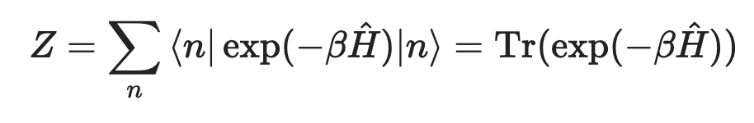
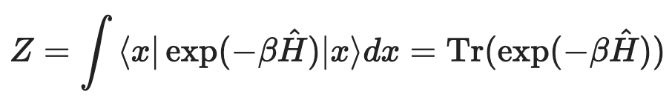
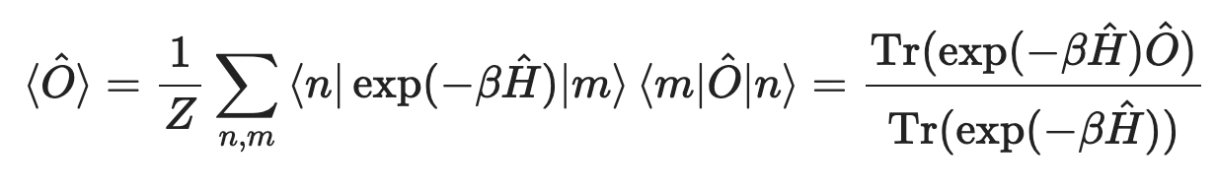
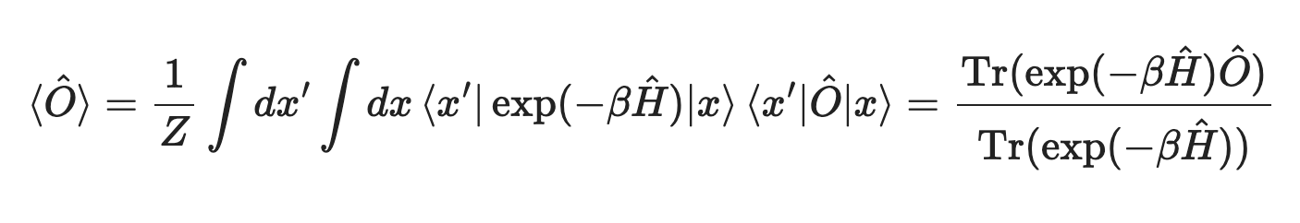
Canonical form

Slide 11
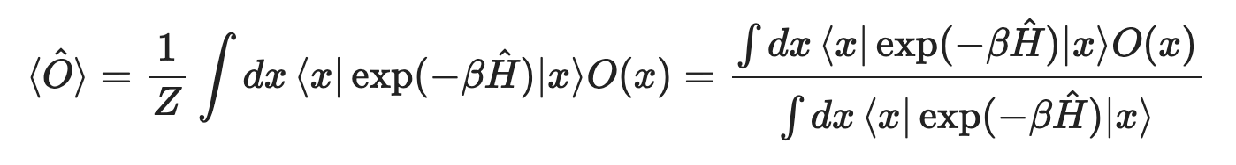
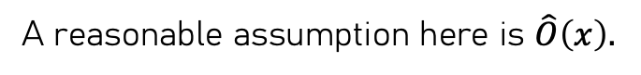
Canonical form
A reasonable assumption here is $\hat{O}\left(x\right).$
Which cancels out one of the integral.

Slide 12

Path Integral?????

Slide 13
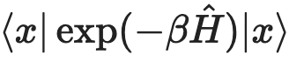
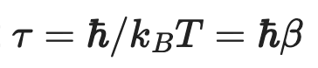
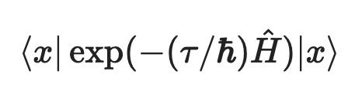
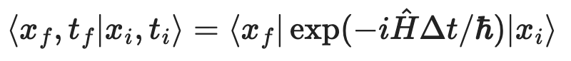
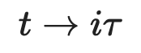
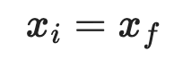
More carefully…
We have (density matrix):
Let’s try some substitution:
And we get:
The propagator is,
To match exactly, (Wick Rotation)

Slide 14
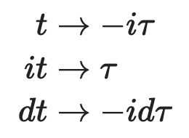
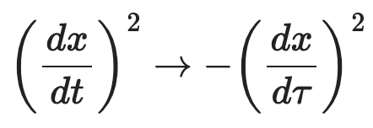
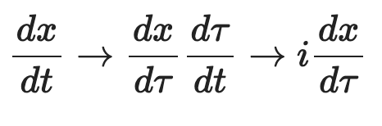
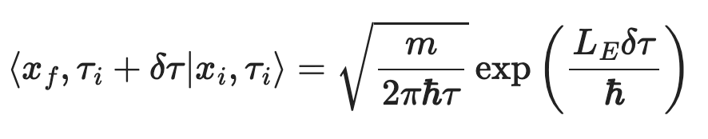
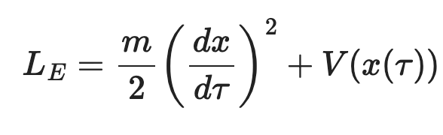
Imaginary Time Path Integral
Some change of variable:
The short time propagator becomes:
Now, the Lagrangian looks different:
(Again from inserting completeness)
(Euclidean Lagrangian)

Slide 15
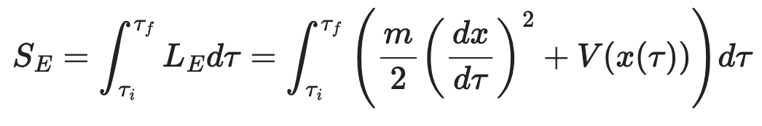
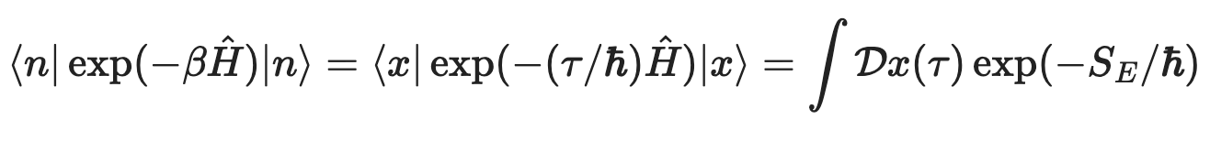

Euclidean Action

Slide 16
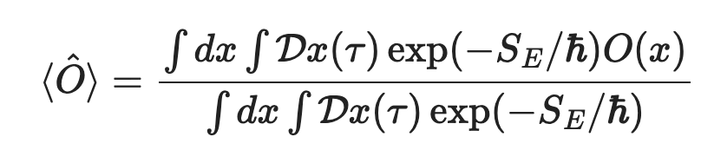

Back to stat mech

Slide 17
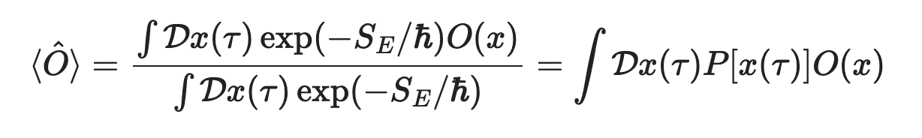
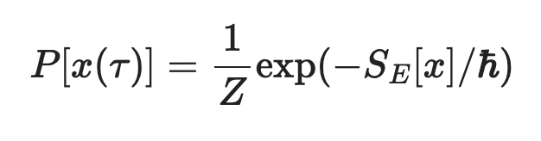

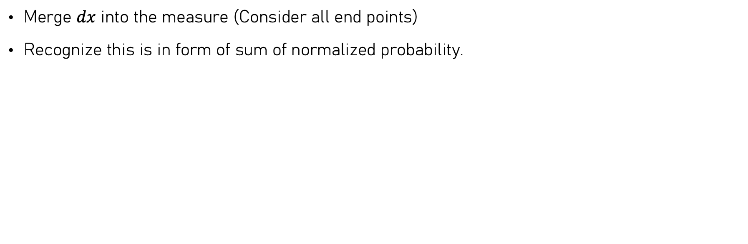

Simplify the expectation value
Merge $dx$ into the measure (Consider all end points)
Recognize this is in form of sum of normalized probability.

Slide 18
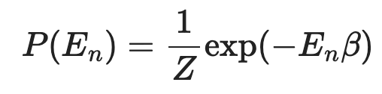
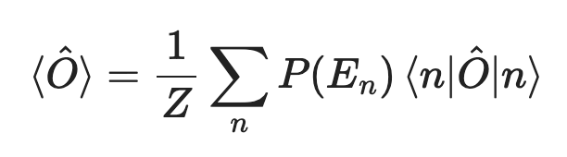
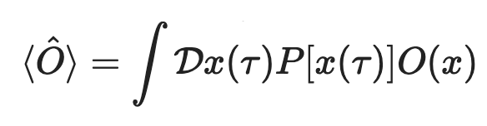
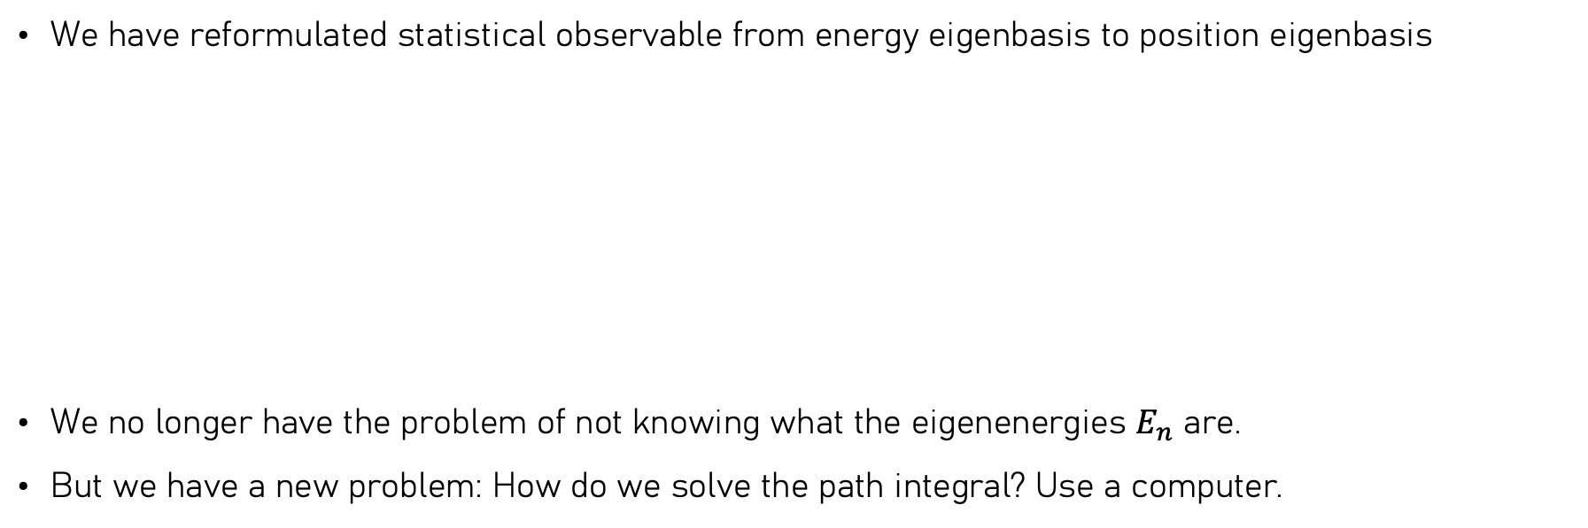
Now what?
We have reformulated statistical observable from energy eigenbasis to position eigenbasis
We no longer have the problem of not knowing what the eigenenergies $E_{n}$ are.
But we have a new problem: How do we solve the path integral? Use a computer.
Becomes

Slide 19
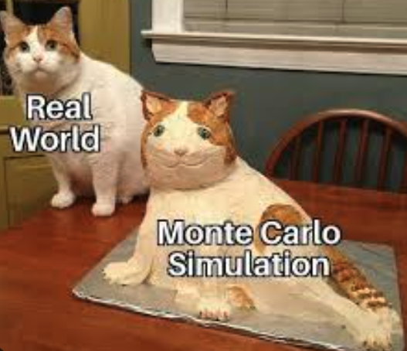

TODO List:
Review Path Integral
Show that Stat Mech = Path Integral (Euclidean Path).
Introduce to Markov Chain Monte Carlo (MCMC) Algorithm.
Metropolis Hasting Algorithm for Path Sampling.
Quantum Harmonic Oscillator Example.

Slide 20
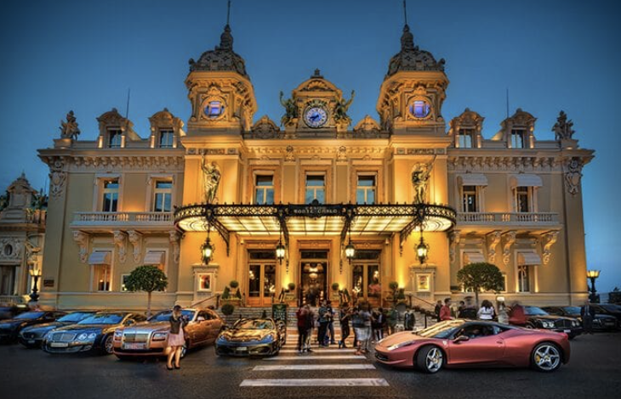
Solving the Imaginary Time Path Integral
Markov Chain Monte Carlo Algorithm (MCMC) !!!
Solve things from statistical sampling.
Get statistical sampling! (Stochastically)

Slide 21



Big Picture, Toy Example: Monte Carlo Methods for Solving Integrals
Mean value theorem tells us,
Evaluating RHS might be hard. Statistical average tells us if we have uniform sampling and number of samples are large enough,
So we have,

Slide 22











Nonuniform sampling?
We don’t have to make sampling uniform, if we sample according to probability$p(x)$,
Let’s compare with our path integral, generalizing to path domain

Slide 23






Sketch of what we need to do…
We now find a way to calculate the path integral.
We sample many path according to
We calculate the observable of that path.
We take average of all these path.
Problem: We still need the partition function $Z$ for sampling path.
Idea: Generate path from perturbing other path according to the distribution. Only relative probability is considered, effectively eliminate the need of $Z.$

Slide 24






Metropolis-Hasting Algorithm : Markov Chain
Pick a random path with periodic condition.
Propose a perturbed path, where $δ$ is symmetric.
Calculate acceptance probability.
Accept the path with that probability
If rejected, then the new path is just the current path.
Idea: Always accept lower action path (move to direction of more configuration). Optionally explore higher action path.
Repeat.

Slide 25











Markov Chain Implementation
Thermalization.
Reduce correlation.
Acceptance rate tuning.
Update many node per metropolis sweep.

Slide 26

I talked and derived a lot. Why should you trust me?

Slide 27

TODO List:
Review Path Integral
Show that Stat Mech = Path Integral (Euclidean Path).
Introduce to Markov Chain Monte Carlo (MCMC) Algorithm.
Metropolis Hasting Algorithm for Path Sampling.
Quantum Harmonic Oscillator Example.

Slide 28




Review: Quantum Harmonic Oscillator
Hamiltonian & Energy levels:
Wave function:
Position Operator:

Slide 29


Review: Quantum Harmonic Oscillator
Position expectation
Variance expectation (From ladder operators)

Slide 30



Put Harmonic Oscillators in Thermal Bath
Partition Function:
Average Thermal Energy:
Average thermal Fluctuation:

Slide 31








Now let’s do it using PIMC
Energy Estimator: Start with partition function in position basis:
Kinetic part is same for all systems (per slice differentiate with $τ$):
Potential Part for H.O. (per slice) is proportional to variance estimator $\left\langle x_{i}^{2}\right\rangle$.

Slide 32






Now let’s do it using PIMC
$\left\langle x_{i}^{2}\right\rangle$ Variance estimator per time slice is simple:
Put them all together,

Slide 33


Thermalization Example
Initial path is random …
We perturb the path to generate more path.
There is no guarantee early generated path follows the probability distribution.
PIMC algorithm needs to “warm up” first before converging.

Slide 34


Autocorrelation Example
Computes how “correlated” data samples are.
Can be reduced by having larger sampling interval.
Wiener-Khinchin Theorem.

Slide 35





Results
Pretty Good!
Quite computationally demanding.
Useless (according to Prof. Michael Hilke)
Don’t be pessimistic! CUDA?

Slide 36


Slide 37

Code is Posted on GitHub!
Ask me for link to repository!
https://github.com/GlacierAS/PIMC_demo
MIT License – Free for use/modify!
Nice LaTeX notes detailing all derivation!

Slide 38






Misc. Topics for Further Reading:
Many particles? Distinguishable, non interacting (Maxwell-Boltzmann Statistics) is easy!
Fermion and Bosons?
Fermi-Dirac Statistics
Bose-Einstein Statistics
We end up with different $Z$ of path integral.

Slide 39
References
Maestro, A.D. (2014). Path Integral Monte Carlo and the Worm Algorithm in the Spatial Continuum.
Westbroek, M. J. E., King, P. R., Vvedensky, D. D., & Dürr, S. (2018). User's guide to Monte Carlo methods for evaluating path integrals. American Journal of Physics, 86(4), 293–304.
Ceperley, D. M. (1995). Path integrals in the theory of condensed helium. Reviews of Modern Physics, 67(2), 279–355.
Creutz, M., & Freedman, B. (1981). A statistical approach to quantum mechanics. Annals of Physics, 132(2), 427–462.
Sankey, J. (2025). PHYS 362 Lecture notes on Statistical Mechanics [Course notes]. McGill University.
Dasgupta, K. (2025). PHYS 551: Lecture on path integral [Blackboard lecture]. McGill University.

